Slide 1


Further Study on Internal Rate of Return
Student name(ID)：FU,Weicheng(20932118), CHEN,chen(20931097), FAN,Haosheng(20888214)

Slide 2
1
Is IRR unreliable?
5 theorems on IRR
2
CONTENTS
3
Different ways for IRR application
4
Example of algorithm implementation
5
Conclusion

Slide 3

Is IRR unreliable？
Original views
New views
Does not be used to rank cash flows for Mutually exclusive projects.
Does not extend well to uncertain situations.
multiple conflicting internal interest rates, or internal interest rates with no real value at all.
Even if there are multiple internal interest rates, they can still be useful, effective, meaningful, correct, interpretable and non contradictory as an explanation of the rate of return.
When there are multiple (even complex value) internal interest rates, each interest rate has a meaningful explanation, that is, the rate of return of its potential investment flow.
Is IRR unreliable?
5 theorems of IRR
Different ways for IRR application
Example of algorithm implementation
Conclusion

Slide 4
5 theorems on IRR
Theorem 1: If investment stream c = (C0, ……, CT-1) yield x = (x0, x1, ……, xT) at constant per-period rate of return k, then for r ≠ -1, PV(x|r) = (k - r) / (1+r) * PV (c|r).
Theorem 2: The quantity k is an internal rate of return for a cash flow stream x if and only if there exists an investment stream c which yields x at constant per-period rate of return k.
Theorem 3: Suppose x is the yield of a pure investment or pure borrowing stream c at a proper internal rate of return k. Then k is the only proper internal rate of return for x, and
a) If x is a pure investment stream, then PV(x | r) > 0 iff k >= r
b) If x is a pure borrowing stream, then PV(x | r) > 0 iff k < = r.
Theorem 4: Suppose k is an internal rate of return for the cash flow stream x, and let c be the investment stream yielding x at constant per-period rate of return k.
a) If PV(c | r) > 0 (that is, c is a net investment) then PV(x I r) > = 0 if and only if A > r.
b) If PV(c | r) < 0 (that is, c is a net borrowing) then PV(x I r) > = 0 if and only if k < r.
c) If PV(c | r) = 0 then PV(x | r) = 0.
Theorem 5: Suppose k is a (possibly complex-valued) internal rate of return for x, and let c be the corresponding (possibly complex-valued) investment stream yielding x at return k.
a. If PV(Re(c) | r) > 0 (that is, Re(c) is a net investment) then PV(x | r) > = 0 if and only if Re(k) > = r.
b. If PV(Re(c) | r) < 0 (that is, Re(c) is a net borrowing) then PV(x | r) > = 0 if and only if Re(k) = < r.
Is IRR unreliable?
5 theorems on IRR
Different ways for IRR application
Example of algorithm implementation
Conclusion

Slide 5
Different ways for IRR
To use an Excel table to calculate and analyze the example, the table can do nothing for the results of multiple k. Only a single discount rate can be calculated. Therefore, excel is a method with obvious limitations, and it is unable to draw the data needed for the most efficient and fast conclusion.
Is IRR unreliable?
Using R code to calculate the value of k and c can deal with complex situations in an all-round way. Even when there are complex-value roots, we can still make decisions according to Theorem 5, which is flexible and can be improved continuously according to conditions. This is the advantage of using the new R Code tool we have developed.
5 theorems on IRR
Different ways for IRR application
Example of algorithm implementation
Conclusion
Excel VS R Code!

Slide 6
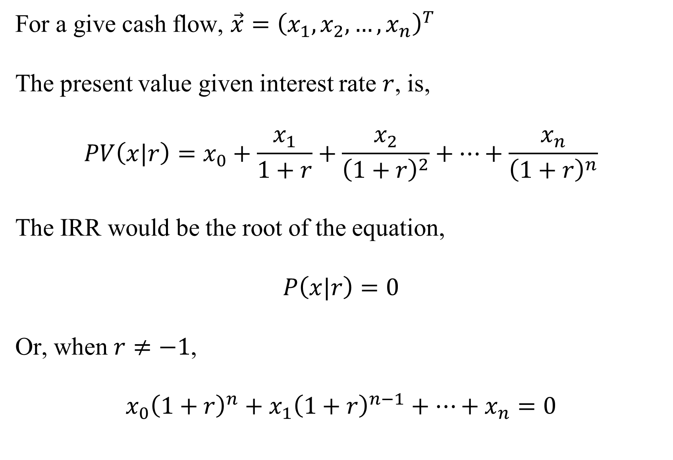
What is IRR mathematically
Is IRR unreliable?
5 theorems on IRR
Different ways for IRR application
Example of algorithm implementation
Conclusion

Slide 7
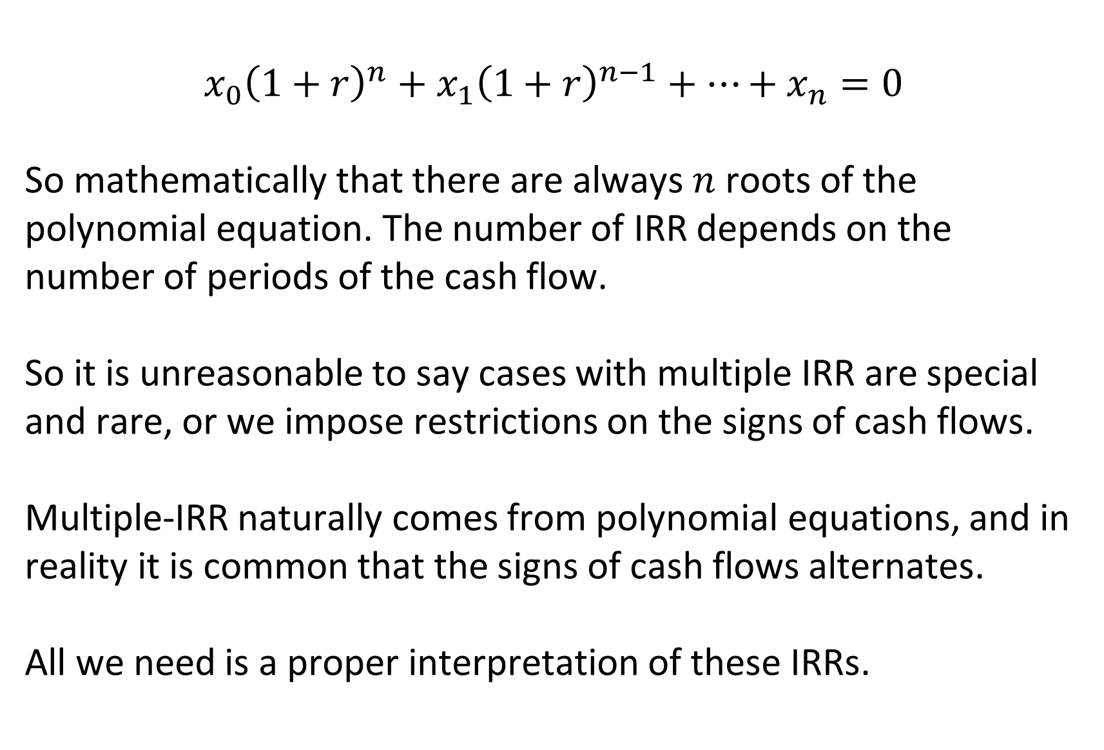
What is IRR mathematically
Is IRR unreliable?
5 theorems on IRR
Different ways for IRR application
Example of algorithm implementation
Conclusion

Slide 8
What is IRR mathematically
We cannot abandon IRR methodology, as it serves as an important complementary element to NPV methodology. We always need a “return” variable to characterize projects.
For any cash flow and market interest rate, a project can only has two status, either getting accepted or getting rejected.
When we obtained multiple IRR, no matter using which, the interpretation should be consistent with 2.
Is IRR unreliable?
5 theorems on IRR
Different ways for IRR application
Example of algorithm implementation
Conclusion

Slide 9
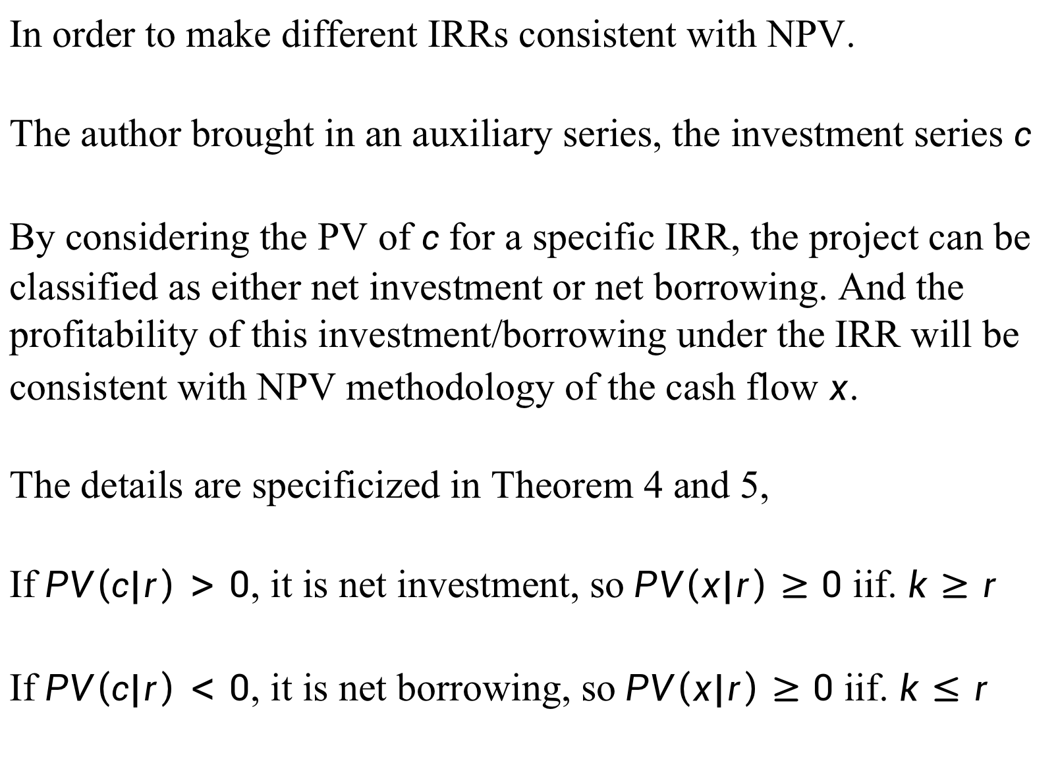
What is IRR mathematically
In order to make different IRRs consistent with NPV.
The author brought in an auxiliary series, the investment series $c$
By considering the PV of $c$ for a specific IRR, the project can be classified as either net investment or net borrowing. And the profitability of this investment/borrowing under the IRR will be consistent with NPV methodology of the cash flow $x$.
The details are specificized in Theorem 4 and 5,
If $PV\left(c|r\right)>0$, it is net investment, so $PV\left(x|r\right)≥0$ iif. $k≥r$
If $PV\left(c|r\right)<0$, it is net borrowing, so $PV\left(x|r\right)≥0$ iif. $k≤r$
Is IRR unreliable?
5 theorems on IRR
Different ways for IRR application
Example of algorithm implementation
Conclusion

Slide 10
An R toolkit for IRR analysis (vs. Excel IRR)
The motivation behind our R toolkit design
Some drawbacks in common IRR data analysis tools, such as Excel,
Excel IRR function cannot yield multiple IRR
For a given IRR, it is difficult to obtain the associated “investment flow” that generate the cash flow
Lack of support for certain plots such as NPV vs Interest Rates
Is IRR unreliable?
5 theorems on IRR
Different ways for IRR application
Example of algorithm implementation
Conclusion

Slide 11
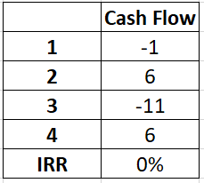
An R toolkit for IRR analysis (vs. Excel IRR)
# R function find all the internal rate of returns for a given cash flow
# polyroot utilizes the Jenkins–Traub algorithm
allirr <- function(xflow)
{
return(polyroot(rev(xflow))-1)
}
# example cash flow that has 3 IRRs.
xflow = c(-1,6,-11,6)
allirr(xflow)
[1] 0 1 2
Excel IRR function can only obtain single IRR
Is IRR unreliable?
5 theorems on IRR
Different ways for IRR application
Example of algorithm implementation
Conclusion

Slide 12
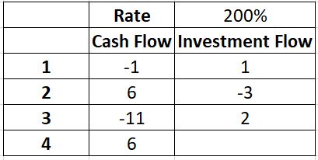
An R toolkit for IRR analysis (vs. Excel IRR)
# function to find the investment flow c from cash flow , given an internal return ir.
cflowFx <- function(xflow, ir)
{
cfidx <- function(idx)
{
return(-sum(rev(OneRSeq[1:idx])*xflow[1:idx]))
}
Lxflow = length(xflow)
OneRSeq = (1+ir)^seq(0,(Lxflow-1))
cflow = rep(0, Lxflow-1)
cflow = sapply(1:(Lxflow-1), cfidx)
return(cflow)
}
# example cash flow with ir = 200%
xflow = c(-1,6,-11,6)
cflowFx(xflow, 2)
[1] 1 -3 2
Formulas for investment flow in Excel depends on period index, so we have to type in for each line and cannot use autofill of Excel.
Is IRR unreliable?
5 theorems on IRR
Different ways for IRR application
Example of algorithm implementation
Conclusion

Slide 13
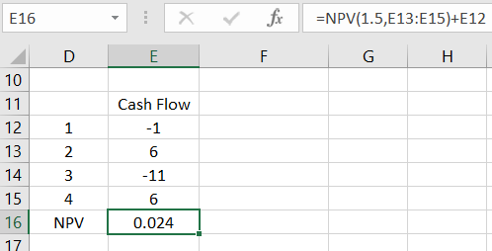
An R toolkit for IRR analysis (vs. Excel IRR)
#function that calculate the pv of a given cash flow and rate ir.
pvfunc <- function(xflow,ir)
{
Lxflow = length(xflow)
OneRSeq = (1+ir)^seq(0,(Lxflow-1))
disfactor = 1/OneRSeq
pv = sum(xflow*disfactor)
pv
}
f1 = c(-1,6,-11,6)
pvfunc(f1, 1.5)
[1] 0.024
For using Excel’s build-in NPV function, the index start from 1, instead of 0.
Is IRR unreliable?
5 theorems on IRR
Different ways for IRR application
Example of algorithm implementation
Conclusion

Slide 14
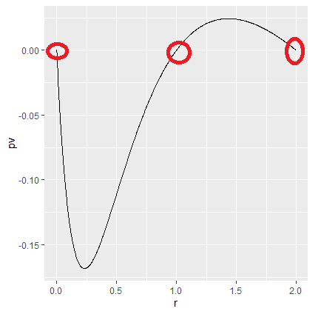
An R toolkit for IRR analysis (vs. Excel IRR)
require(ggplot2)
# function generate a PV vs rate data frame for ggplot
PlotPVdf <- function(xflow)
{
discrates = Re(polyroot(rev(xflow))-1)
discrates
R_range = seq(min(discrates),max(discrates),length.out = 1000)
R_range = R_range[(R_range> (-0.999)) | (R_range < (-1.001))]
Lxflow = length(xflow)
pvfunc <- function(ir)
{
OneRSeq = (1+ir)^seq(0,(Lxflow-1))
disfactor = 1/OneRSeq
pv = sum(xflow*disfactor)
pv
}
pv_s = sapply(R_range, pvfunc)
pvdf = data.frame(r=R_range, pv = pv_s)
return(pvdf)
}
xflow = c(-1,6,-11,6)
Plotdf = PlotPVdf(xflow)
ggplot(plotdf,aes(x = r,y = pv))+geom_line()
Is IRR unreliable?
5 theorems on IRR
Different ways for IRR application
Example of algorithm implementation
In Excel we don’t have this functionality directly!
Conclusion

Slide 15

Conclusion
In the past theories, IRR is very limited. However, according to the new five theorems and the tools developed by us, we can accurately make decisions on whether this project is desirable, whether it is a net loan or a net investment, among a variety of or even a complex number of IRR values. It also makes a meaningful analysis of each value of multiple internal interest rates, rather than simply ignoring them. Taking into account all these factors, we may reasonably enable to the conclusion that we have completed further research on the important concept of internal rate of return and rediscovered its new value. Our tool is very powerful, and ultimately it can open a wider perspective in complex decisions, providing more accurate estimate basis for our earnings.
Is IRR unreliable?
5 theorems on IRR
Different ways for IRR application
Example of algorithm implementation
Conclusion

Slide 16
Q&A
Thank you!

